Slide 1
PRESENTATION
TOPIC
  Exploratory Decomposition
  Speculative Decomposition
  Hybrid Decomposition

Slide 2
Group Members
Sharyar Khan (19-Arid-5253)
Bilal Raza (19-Arid-5149)
Ameer Hamza (19-Arid-5136)
Faizan Nazir (19-Arid-5157)

Slide 3
Decomposition
Decomposition is a common technique used in parallel computing to break a large problem down into smaller, more manageable subtasks that can be solved concurrently. There are several different types of decomposition that can be used, depending on the nature of the problem and the available hardware resources.

Slide 4
Decomposition Techniques
Commonly used techniques that apply to broad classes of problems. These include:
• Recursive decomposition
• Data decomposition
• Exploratory decomposition
• Speculative decomposition
• Hybrid decomposition

Slide 5
Exploratory Decomposition
In many cases, the decomposition of the problem goes hand-in-hand with its execution.
These problems typically involve the exploration (search) of a state space of solutions.
Problems in this class include a variety of discrete optimization problems (0/1 integer programming, QAP, etc.), theorem proving, game playing, etc.

Slide 6
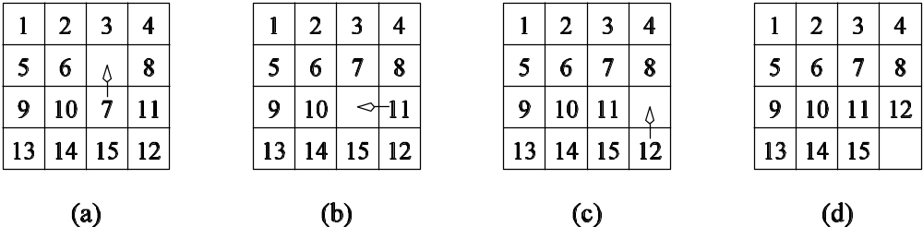
Exploratory Decomposition: Example
The solution to a 15 puzzle (a tile puzzle). We show a sequence of three moves that transform a given initial state (a) to desired final state (d).
Of-course, the problem of computing the solution, in general, is much more difficult than in this simple example.

Slide 7
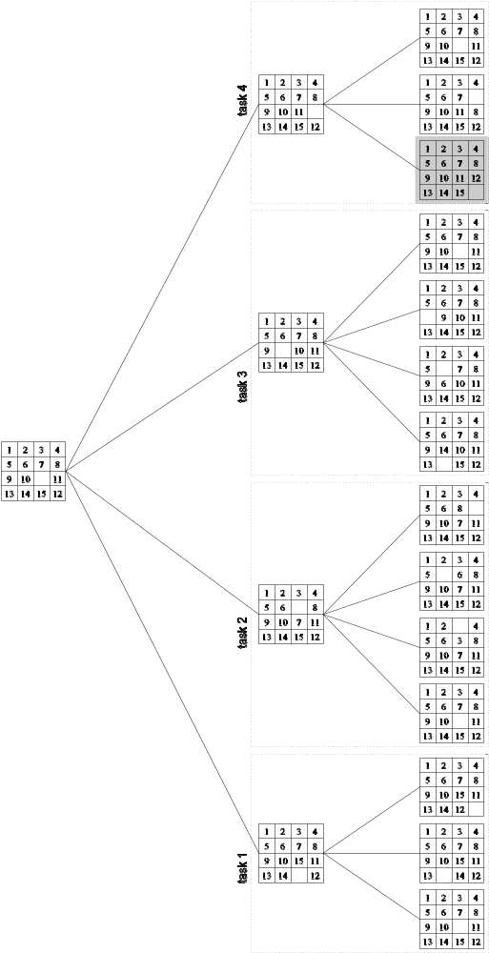
Exploratory Decomposition: Example
The state space can be explored by generating various successor states of the current state and to view them as independent tasks.

Slide 8
Speculative Decomposition
• Another special purpose decomposition technique is called
speculative decomposition.
• In the case when only one of several functions is carried out
depending on a condition (think: a switch-statement), these
functions are turned into tasks and carried out before the condition is even evaluated.
• As soon as the condition has been evaluated, only the results of one task are used, all others are thrown away.
• This decomposition technique is quite wasteful on resources and seldom used.

Slide 9
Speculative Decomposition: Example
Sequential version
compute expr;
switch (expr)
{
case 1: compute a1;
break;
case 2:
compute a2;
break;
case 3:
compute a3;
break;... }
Parallel version
Slave(i)
{
compute ai;
Wait(request);
if (request)
Send(ai, 0);
}
Master()
{ compute expr;
switch (expr)
{ case 1: Send(request,1);
Receive(a1, i); ... }

Slide 10
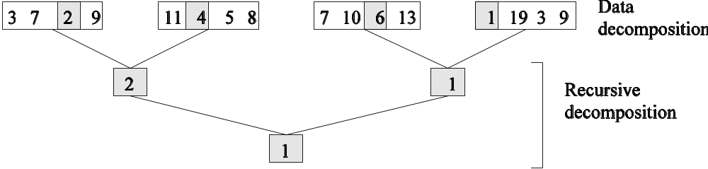
Hybrid Decompositions
A mix of decomposition techniques is necessary for decomposing a problem. Examples:
In quicksort, recursive decomposition alone limits concurrency (Why?). A mix of data and recursive decompositions is more desirable.
In discrete event simulation, there might be concurrency in task processing. A mix of speculative decomposition and data decomposition may work well.
Even for simple problems like finding a minimum of a list of numbers, a mix of data and recursive decomposition works well.

